Slide 1

UNITED NATIONS GLOBAL GEODETIC
CENTRE OF EXCELLENCE
MODERNISING GEOSPATIAL REFERENCE SYSTEM
CAPACITY DEVELOPMENT WORKSHOP
Aligning national geodetic datums to ITRF
Nicholas Brown
Head of Office, UN-GGCE
Day 1, Session 2 [1_2_3]
HOW
Acknowledgements: Zuheir Altamimi (FRA); Detlef Angerman (TUM); Johannes Bouman (GER); Jan Dostal (UN-GGCE); Andrick Lal (SPC); Anna Riddell (AUS); Jeffrey Verbeurgt (BEL).
Notes:
Introduction/Overview
If you want to build a model / reference frame for the Earth - how do we do it?
You need different geodetic techniques because they are complementary.
You can't build it using only VLBI or only SLR; you need VLBI for scale, shape and spin rate; you need SLR for the CoM and you need GNSS for densifying the network and providing access to the reference frame.

Slide 2
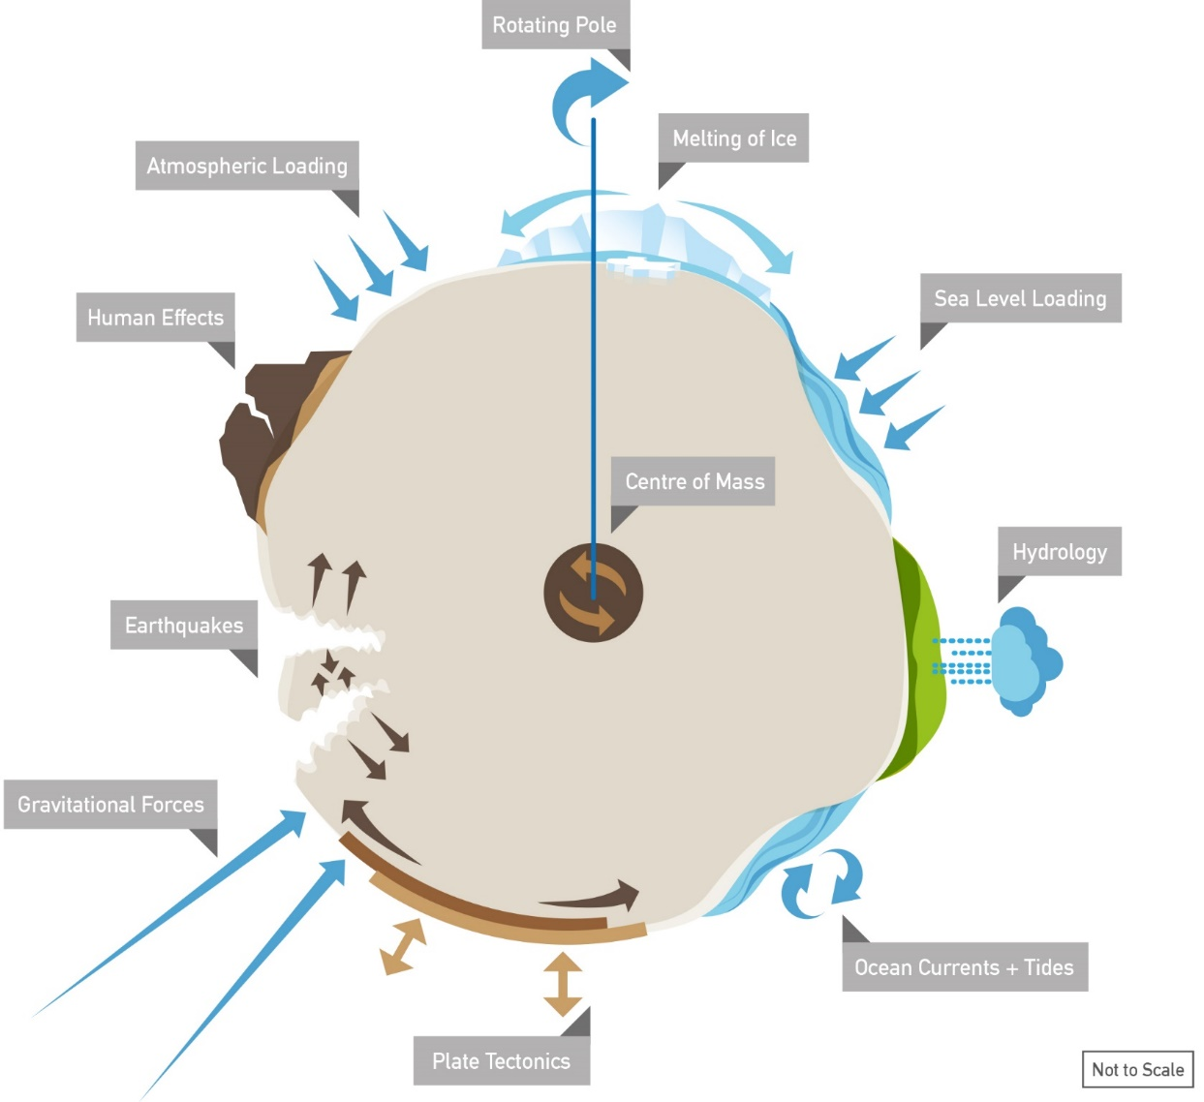
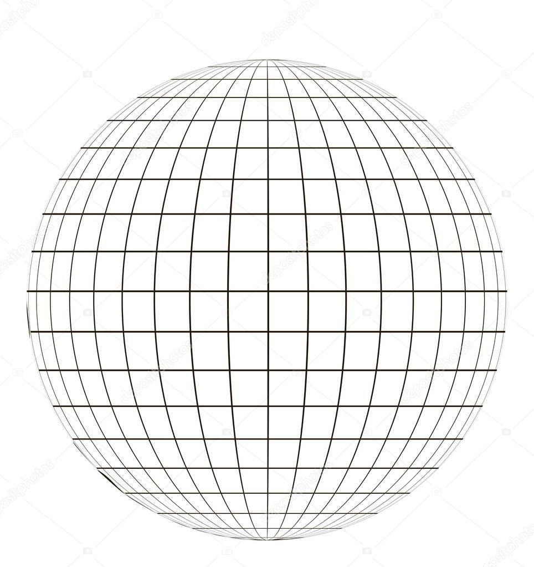

z
If you can’t measure it;
you can’t manage it.
x
y
Source: Dr Anna Riddell, Geoscience Australia
STRONGER.
TOGETHER.
Notes:
A brief introduction for those of you who don’t know much about geodesy.
Geodesy is the science of measuring the Earth’s shape, orientation and gravity field and how it changes over time.
You see, many people don’t think about the Earth changing, but it is dynamic - it is constantly changing.
Gravitational forces from the sun and the moon create tides.
Tectonic plate motion causes earthquakes.
Melting of ice alters ocean currents and is causing sea level rise.
Geodesy helps us in two amazing ways.
Firstly using the science of geodesy we can create Reference Frames:
These reference frames are like a zero point on the ruler. They provide an model of the Earth needed for positioning, navigation and to align geospatial data
The second way geodesy helps us is to make accurate Measurements with respect to the reference frame. This allows us to measure:​
the spin rate of the Earth (for accurate time)​
the position and movements of satellites (for positioning and navigation on Earth)​
the movement of tectonic plates (to align geospatial data)
The changes to our environment (such as sea level variation)
​
The accuracy a user can achieve when positioning, navigating or aligning geospatial data is dependent on the accuracy of the geodetic observations AND reference frame. Geodesy does both!
We often say, If you can’t measure it, you can’t manage it. Well – a key foundation to measure it and manage is geodesy

Slide 3
Motivation
Accurate Positioning and Navigation
GNSS are closely aligned to ITRF.
Alignment of a country datum to ITRF ensures that geospatial data within a country aligns seamlessly with satellite positioning, enabling high-precision navigation and surveying.
Global Consistency and Standardization
The ITRF provides a globally consistent reference system.
By aligning national geodetic datums to it, countries ensure their geospatial data and mapping systems are interoperable with others. This is essential for international cooperation in areas like navigation, aviation, and disaster management.
Improved Scientific Research
The ITRF supports Earth science research, including plate tectonics and crustal motion, sea-level rise monitoring through precise satellite altimetry and tracking changes in the Earth's gravity field for applications like understanding mass redistribution (e.g., melting glaciers).
Aligned datums allow local data to contribute meaningfully to these global scientific efforts.
STRONGER.
TOGETHER.
Notes:
Need speaker notes

Slide 4
Motivation
Disaster Management
Precise and consistent geodetic data is critical for natural disaster prediction, monitoring, and response. For example, accurate positioning aids in early warning systems for earthquakes, tsunamis, and landslides.
Post-disaster, consistent datums ensure rescue operations and recovery efforts are coordinated effectively across borders.
Economic Efficiency
Misaligned geodetic datums can lead to costly errors in infrastructure projects, such as pipelines, bridges, and cross-border transportation networks. Alignment reduces discrepancies, minimizing errors and disputes in construction, land management, and resource allocation.
What other benefits do you know of?
STRONGER.
TOGETHER.
Notes:
Need speaker notes

Slide 5
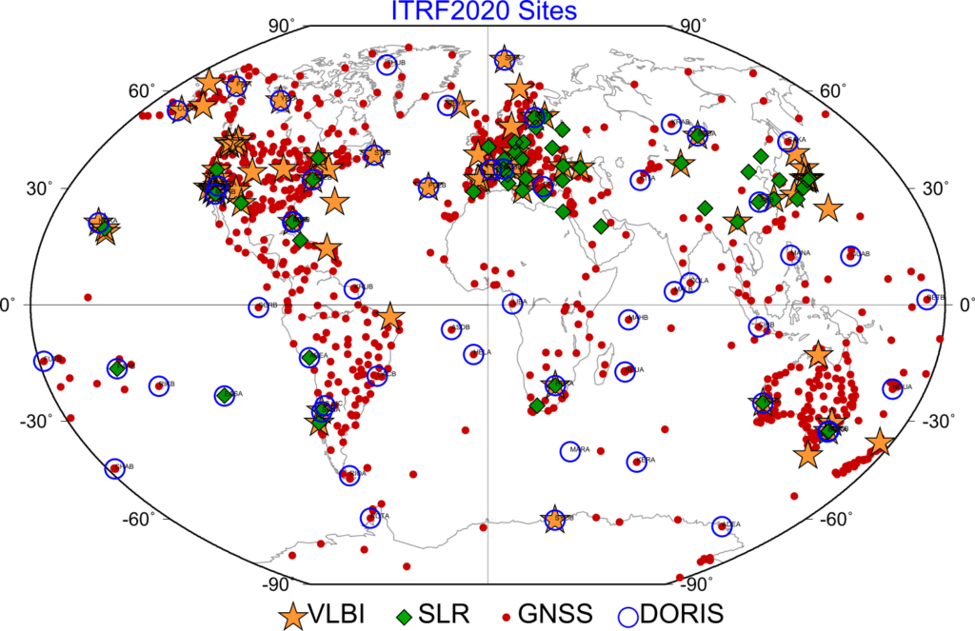
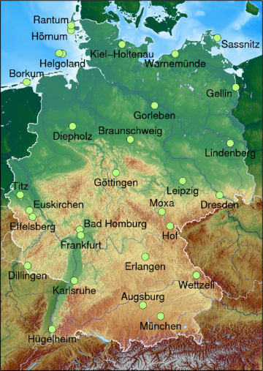
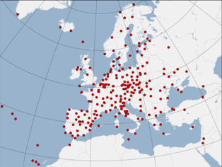
Motivation
Aligned
Global
National (Germany)
Regional (Europe)
Aligned
Aligned
International Terrestrial Reference Frame
Time dependent
Regional
Continental plate
Static / Time dependent
Static / Time Dependent
STRONGER.
TOGETHER.
Notes:
In some regions, like Europe, Asia Pacific and Americas, there exist also regional reference frame, which is kind of a denser version of ITRF in those particular regions with extra GNSS stations included.
The regional datum is therefore aligned to the ITRF and to the national static datum.
These different reference frames cover different needs, but are related to each other.
This is done by some points of the national static datum that are included by the realization of regional and global reference frames.

Slide 6
How to align a National Geodetic Datum with ITRF
ITRF2020
Choose an ITRF realisation and epoch to align to (e.g. ITRF2020@2024)
Include the GNSS CORS from your country in the regional reference frame (if possible)(e.g EUREF)
The positions from the GNSS CORS in your country which are analysed in the regional reference frame are used as the constraint in the national adjustment.
Regional Reference Frame
National Geodetic Datum
STRONGER.
TOGETHER.

Slide 7
How to align a National Geodetic Datum with ITRF
GNSS CORS
GNSS CORS included in regional reference frame
STRONGER.
TOGETHER.
Notes:
And now you see that some points have a coordinates in both the regional reference frame (or ITRF) and the national geodetic datums – points with red cross and blue dot.

Slide 8
Example: Pacific Island Countries
Australia has been supporting 13 Pacific Island countries (PICs) to measure, record and analyse long-term sea level and land motion for over 25 years. This is known as the Pacific Sea Level and Geodetic Monitoring (PSLGM) project which is funded by Australian Aid under the Climate and Oceans Support Program in the Pacific (COSPPac).
The sea level data is collected continuously at one or two tide gauges in each of the 13 PICs. The land motion data is collected continuously at one or two Global Navigation Satellite System (GNSS) stations in each of the 13 PICs.
The height difference between the tide gauges and GNSS stations is observed once every 18 months (approximately). The data is then analysed to produce sea level information-based products (e.g. tide calendars) and to inform about motion of the land (e.g. for coastal infrastructure planning).
STRONGER.
TOGETHER.
Source: Geoscience Australia

Slide 9
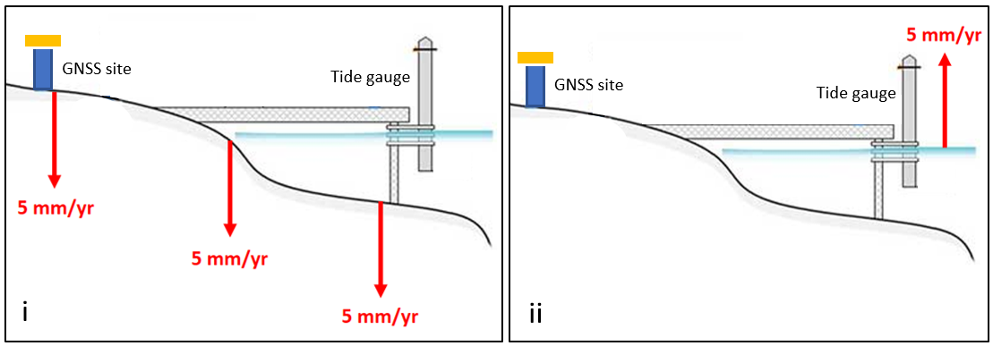
Example: Pacific Island Countries
A tide gauge alone cannot differentiate between changes in the sea level height and movement of the land or wharf the tide gauge is attached to.
If a tide gauge is observing 5 mm/yr rise in sea level, we are unable to distinguish whether the land to which the tide gauge is connected is subsiding by 5 mm/yr, the sea level is rising by 5 mm/yr, or some combination of both.
[i] land subsiding at a rate of 5 mm/yr with no change to absolute sea level; [ii] absolute sea level rising by 5 mm/yr and no movement of the land.
Source: Geoscience Australia
STRONGER.
TOGETHER.

Slide 10
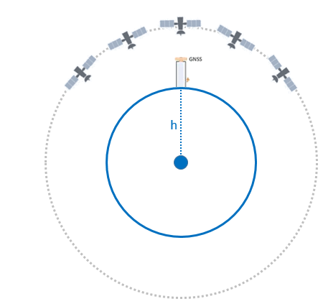
Example: Pacific Island Countries
To distinguish between relative and absolute sea level variation from tide gauge data, it is necessary to know the movement of the tide gauge in an absolute frame of reference.
The absolute frame of reference we use is the centre of the Earth.
In the Pacific Island countries a GNSS site is located within 1-5 km of the tide gauge. At these GNSS sites, it is possible to determine the absolute height of the GNSS site.
STRONGER.
TOGETHER.
GNSS heights can be measured with respect to the centre of the Earth.
Source: Geoscience Australia

Slide 11
Example: Pacific Island Countries
Source: Geoscience Australia
STRONGER.
TOGETHER.

Slide 12
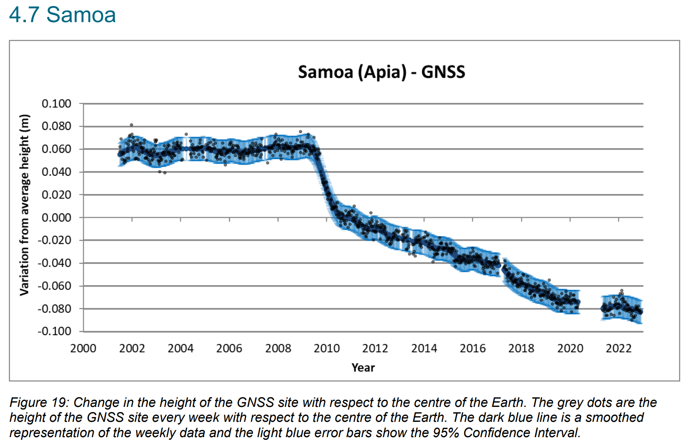
Source: Geoscience Australia

Slide 13
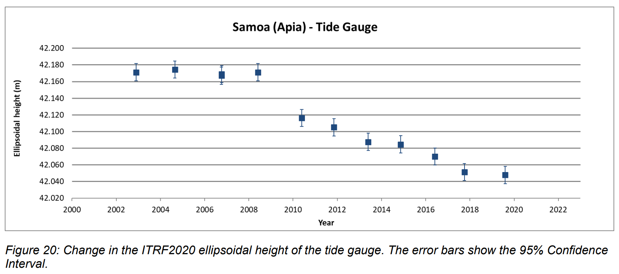
Source: Geoscience Australia

Slide 14
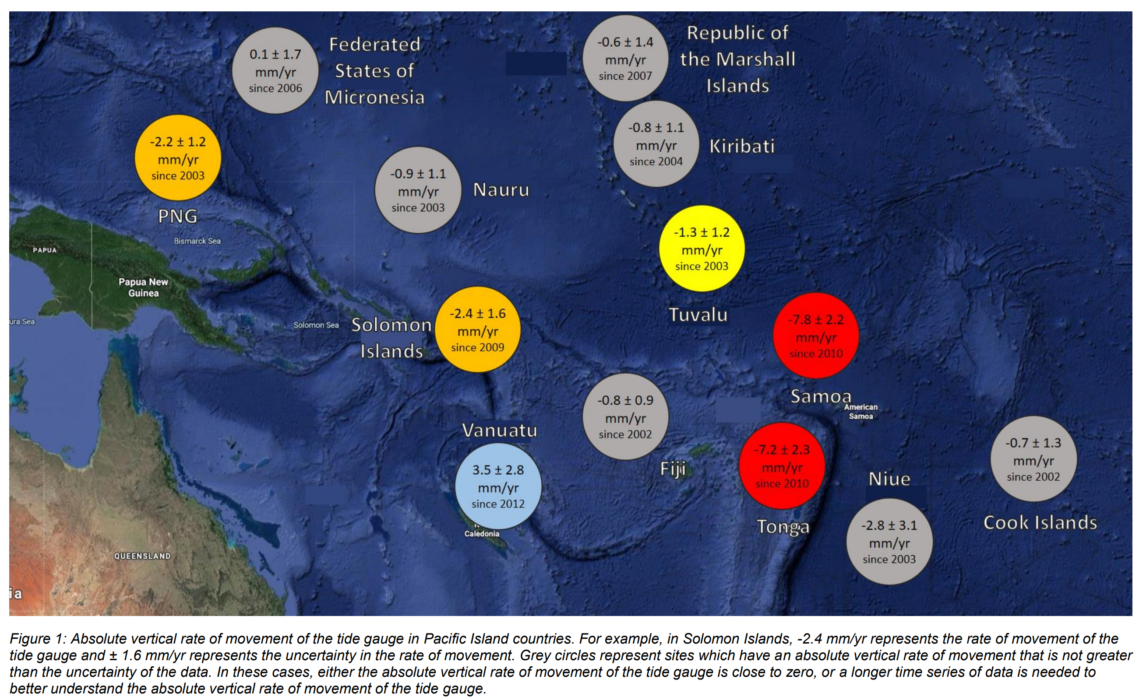
Source: Geoscience Australia

